Slide 1


FINANCE AND RISK ANALYTICS
A Data-Driven Approach to Portfolio Management

Slide 2
AGENDA
Objective
Methodology
Insights and Visualization
Portfolio Analysis

Slide 3
OBJECTIVE
Analyze a stock portfolio and provide investment consultation tailored to client requirements.
Client Profiles:
Mr. Patrick Jyengar (Conservative Investor)
Investment Amount: $500K in equities
Risk Appetite: Low-risk investments
Financial Goal: Double capital in 5 years with minimal risk
Mr. Peter Jyengar (Aggressive Investor)
Investment Amount: $1 million in equities
Risk Appetite: High-risk, high-return investments
Financial Goal: Double capital in 5 years with higher risk exposure
Task: Develop personalized investment strategies aligning with their financial objectives and risk tolerance.

Slide 4

METHODOLOGY

Slide 5
EXPLORATORY DATA ANALYSIS (EDA)
Checked for missing values: No columns were identified with null values.
Outlier detection: Examined and addressed potential outliers in the dataset.
Data imputation: Since Facebook was listed on NYSE only on May 18, 2012, missing values before this date were imputed as 0.
DATA ANALYSIS
Performed key financial calculations:
Daily Returns – Measured stock price fluctuations.
Cumulative Daily Returns – Tracked overall stock trends.
Sharpe Ratios – Assessed risk-adjusted returns.
Portfolio Risk & Return on Investment (ROI) – Evaluated portfolio performance.
Identified top-performing stocks for portfolio recommendations.
Utilized Power BI for interactive visualizations and insights.
Conducted sector-wise analysis to understand market behavior.
KEY INFERENCES FROM DATA ANALYSIS
Top-Performing Stocks: Identified 7 stocks that provided 80%+ returns in the last five years:
Amazon, Microsoft, Apple, Facebook, UnitedHealth Group, Google, and Morgan Stanley.
Risk-Return Tradeoff:
Amazon had the highest return but also carried a higher risk.
Johnson & Johnson, Roche Holding, Merck, and Microsoft provided good returns with lower risk.
Sector Performance:
Best-performing sector: Technology, followed by Finance.
Worst-performing sector: Aviation, followed by Healthcare & Pharma.
Final Portfolio Selection: Based on our analysis, we optimized investment portfolios tailored to both clients' risk appetites and financial goals.

Slide 6

INSIGHTS AND VISUALIZATION

Slide 7
Ticker | Industry | Company Name
AAL | Aviation | American Airlines Group Inc
ALGT | Aviation | Allegiant Travel Company
ALK | Aviation | Alaska Air Group Inc
DAL | Aviation | Delta Air Lines Inc
HA | Aviation | Hawaiian Holdings Inc
LUV | Aviation | Southwest Airlines Co
BCS | Finance | Barclays
CS | Finance | Credit Suisse
DB | Finance | Deutsche Bank
GS | Finance | Goldman Sachs
MS | Finance | Morgan Stanley
WFC | Finance | Wells Fargo
JNJ | Healthcare | Johnson & Johnson
MRK | Healthcare | Merck and CO inc.
PFE | Healthcare | Pfizer inc
UNH | Healthcare | UnitedHealthGroup Inc
BHC | Pharmaceuticals | Bausch Health Companies inc
RHHBY | Pharmaceuticals | Roche Holding AG
AAPL | Technology | Apple Inc
AMZN | Technology | Amazon
FB | Technology | Facebook
GOOG | Technology | Alphabet
IBM | Technology | IBM
MSFT | Technology | Microsoft
STOCKS DATA AVAILABLE
A total of 24 stocks are available, categorized into four sectors, with six stocks from each sector.
Benchmark Index: The S&P 500, which represents the top 500 stocks in the U.S. stock market, is used for comparison to assess stock performance.
Here is the list of stocks along with their abbreviation, industry, and company name.

Slide 8
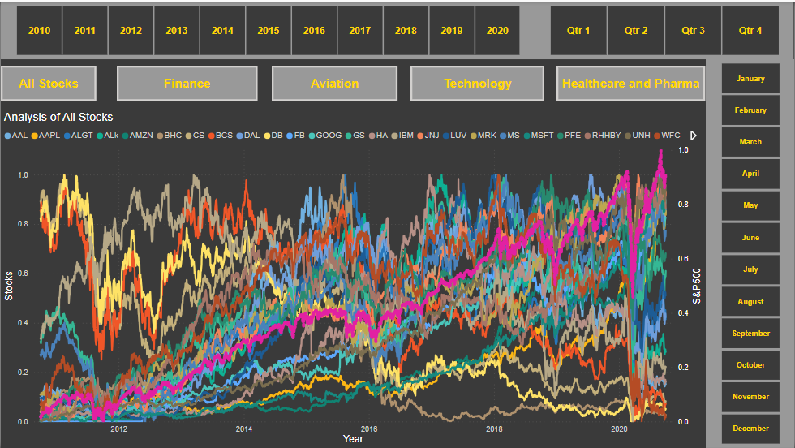
VISUALIZATION OF STOCKS AFTER NORMALIZING THE VALUES
10-year comparison of stock values against the S&P 500 index to identify trends.
Facebook (Meta) entered the market on May 18, 2012, impacting its data timeline.
Interactive dashboard with sector-specific buttons has been added for deeper analysis.

Slide 9
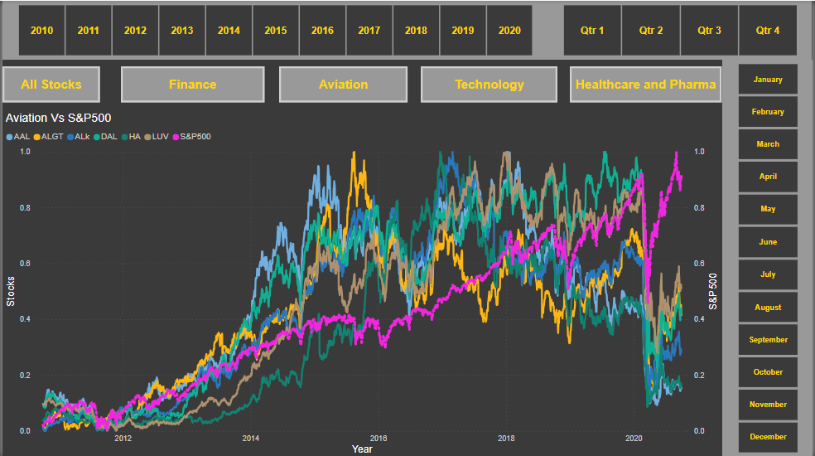
SECTOR WISE ANALYSIS : AVIATION
S&P500 is not co-related to Aviation Sector.
Market took a massive hit in 2020 due to corona pandemic which resulted in a bear market.
Even though the market recovered but the Aviation Sector underperformed the market.
As we can see Allegiant Travel Company has some positive correlation with Delta Airlines.
Also we can see there is some positive correlation of Delta Airlines with Southwest Airlines.

Slide 10
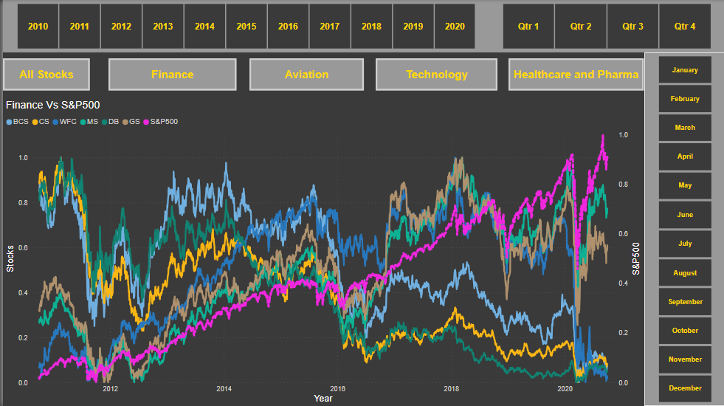
SECTOR WISE ANALYSIS : FINANCE
Positive correlation observed between S&P 500 and the Finance sector.
Despite the 2020 market crash, Morgan Stanley and Goldman Sachs rebounded and outperformed the sector.
Goldman Sachs & Morgan Stanley show high correlation compared to other stocks

Slide 11
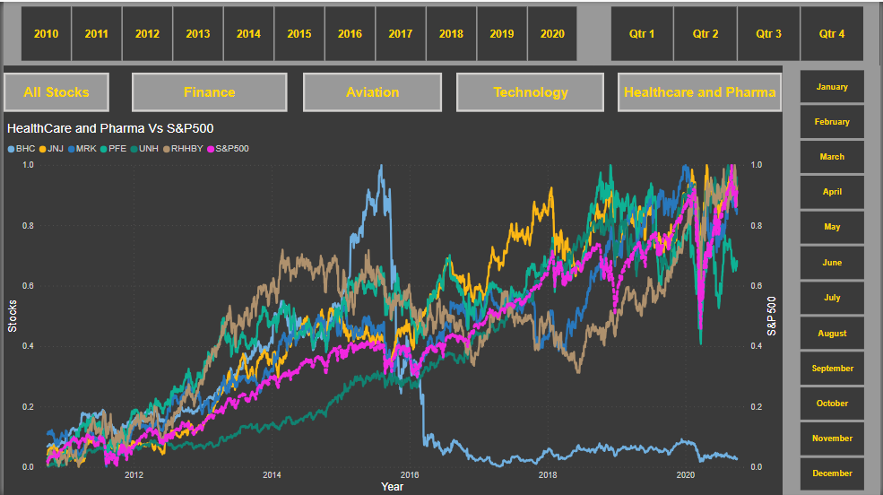
SECTOR WISE ANALYSIS : PHARMA & HEALTHCARE
S&P 500 shows a positive correlation with Johnson & Johnson, Merck, and United Health Group.
Health, Pharma, and Technology sectors rebounded rapidly after the pandemic market crash.
Bausch Health Companies Inc. has shown no growth in the past 5 years, while the overall sector remains strong compared to S&P 500.

Slide 12
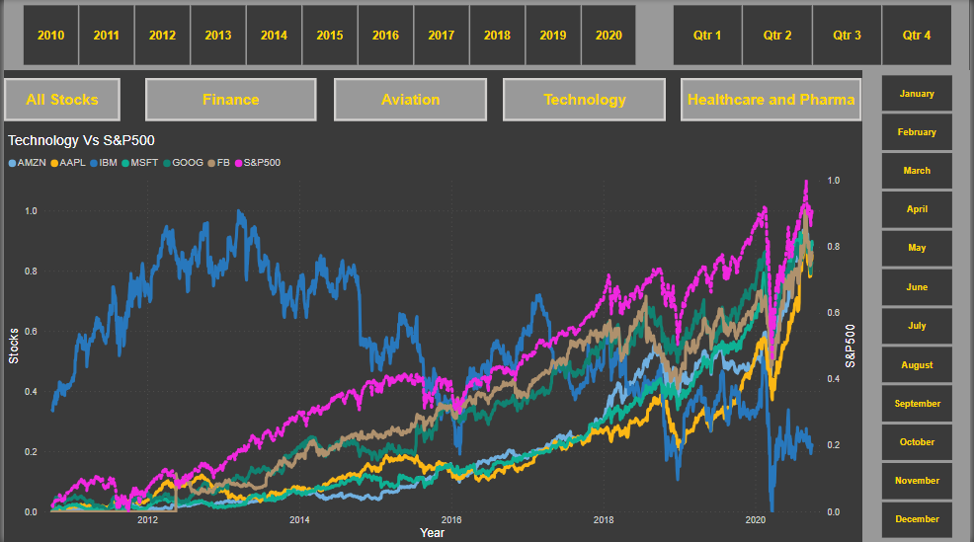
SECTOR WISE ANALYSIS : TECHNOLOGY
S&P 500 is strongly correlated with Amazon, Facebook, Microsoft, Google, and Apple.
Tech sector rebounded sharply after the pandemic, unlike many other sectors.
All tech stocks except IBM are outperforming the market and are strongly correlated with each other.

Slide 13
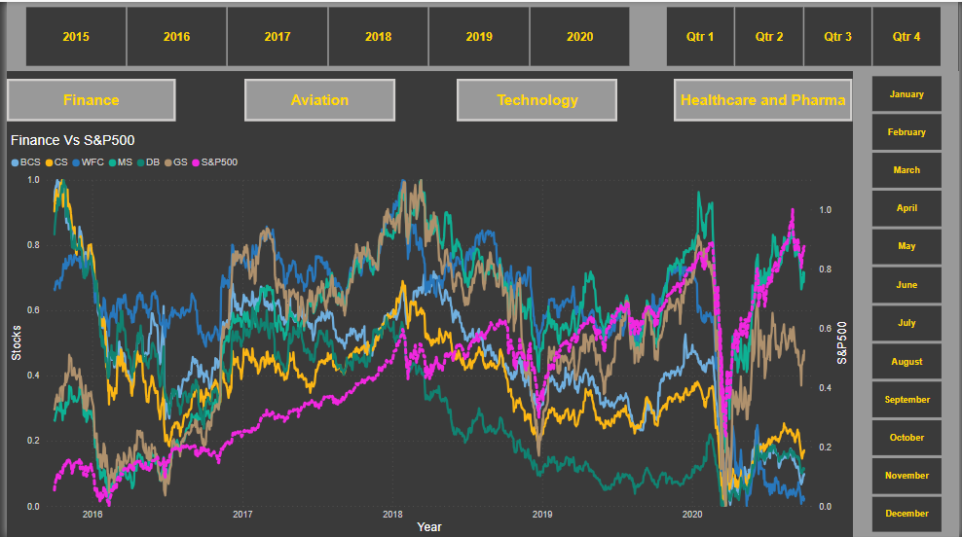
VISUALIZATION OF STOCKS (PAST 5 YEARS)
Created an interactive dashboard to analyze and visualize five years of stock performance.

Slide 14
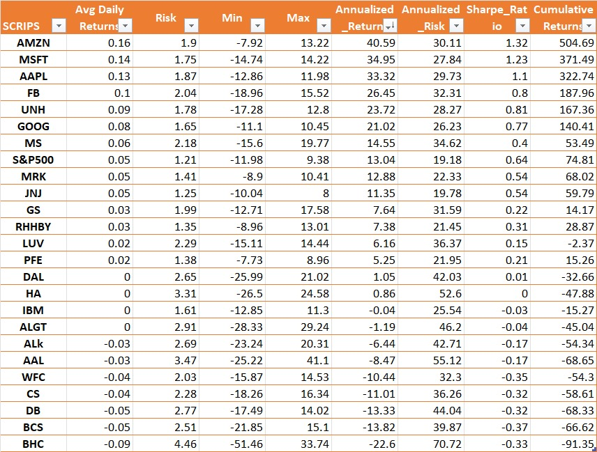
At the end of 5 years, the top 7 stocks outperformed the S&P 500 in returns
Amazon: 40.59% annual returns
Microsoft: 34.95% annual returns
Apple: 33.32% annual returns
Facebook: 26.45% annual returns
United Health Group: 23.72% annual returns
Google: 21.02% annual returns
Morgan Stanley: 14.55% annual returns
S&P 500: 13.04% annual returns

Slide 15
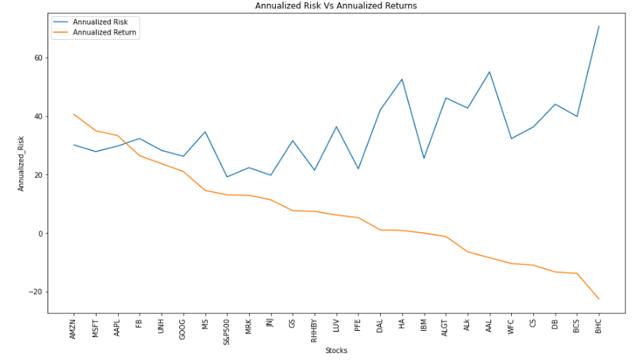
ANNUALIZED RETURN & ANNUALIZED RISK
Top 5 Stocks by Annualized Return: Amazon, Microsoft, Apple, Facebook, and United Health Group, each with returns above 20%.
Moderate Risk: These top stocks carry a balanced risk compared to other equities.
High-Risk Stocks: Bausch Health, Barclays, Deutsche Bank, Credit Suisse, and Wells Fargo show higher risk with no ROI at initial investment.
Risk vs. Return: Higher risk generally results in lower ROI, but some stocks provide stable, low-risk investments.
Low-Risk, Good Returns: Johnson & Johnson, Roche Holding, and Merck offer steady returns with minimal risk.

Slide 16

PORTFOLIO ANALYSIS

Slide 17
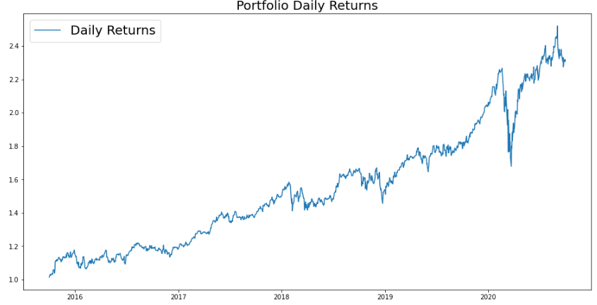
Patrick Jyengar Portfolio
Risk Appetite: Mr. Patrick Jyengar seeks low-risk investments with stable returns to triple his investment in five years.
Stock Selection: Johnson & Johnson, Roche Holding, and Google align with his risk profile, but their combined returns fall short of his target.
Portfolio Adjustment: Allocating a portion of his investment to Microsoft enhances returns while maintaining a balanced risk approach.
Projected Returns: A $500K investment is expected to grow to $1.15M in five years, generating a gain of over $600K.

Slide 18
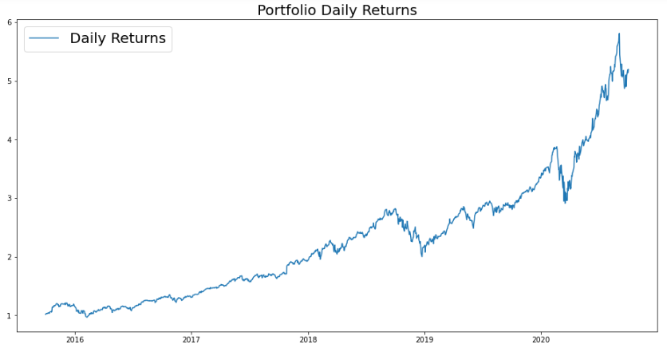
Peter Jyengar Portfolio
Risk Appetite: Mr. Peter Jyengar prefers high-return investments and is willing to take risks, believing he can recover from occasional losses.
Investment Objective: Plans to invest $1M from company funds in high-margin stocks to drive inorganic expansion.
Stock Selection: High-risk, high-reward stocks like Amazon, Microsoft, and Apple best suit his investment strategy.
Projected Returns: His investment is expected to grow beyond $5M in five years, generating over $4M in gains.

Slide 19
Thank You

